Slide 1




Slide 2
JVM
Why and What

Slide 3
Code Reuse
Script - Copy and Paste
Function – a reusable block code
Can be used only inside the program file in which it is defined
Header file – A collection of function
Must be included in program files
All the functions in the header will be copied into the program file
If 2 or more prg files include the same header there will be multiple of the same function in the app

Slide 4
Access modifiers, classes, methods
Public function / methods
Public methods defined in a class can be accessed by other classes with the same project
2 or more Applications running in the same machine can not access each others methods
RPC – accessing remote applications
RMI – LAN ( not internet friendly )
Web service / RESTful Applications

Slide 5
process
PPT
RPC
Remoting
Word
GOTO Webinar
In-proc
xls
Chrome
Eclipse
OS
CPU

Slide 6
Client
JRMIP
RMI
Java Service
TCP
Client
RMI

Slide 7
8 bit
16 bit
32 bit
64 bit
8 bit Code
16 bit Code
64 bit Code
Portability
HW
OS
High level Code
High level Code
32 bit
Low level Code
Low level Code
Low level Code
VM
VM
32 bit OS
32 bit OS
64 bit OS
32 bit HW
32 bit HW
64 bit HW

Slide 8
Write code
<<High level code>>
High level Code
Compiler
Developer Computer
JVM
Security Provider
Thread Manger
Exception Manager
GC
JITC
Stack walker
32 bit app
Layout Manger
Native code
<<Low level code>>
64 bit app
Class Loader
32
emulator
32 bit OS
64 bit OS
64 bit OS
32 bit HW
64 bit HW
64 bit HW
User Computer

Slide 9
Java code
<<High level code>>
Hello.java
Hello.class
Javac
Byte code
<<High level code>>
JVM
JVM
Byte code
<<High level code>>
Byte code
<<High level code>>
Byte code
<<High level code>>
jitc
jitc
Native code
<<Low level code>>
Native code
<<Low level code>>
32 bit OS
32 bit OS
64 bit OS
32 bit HW
32 bit HW
64 bit HW

Slide 10
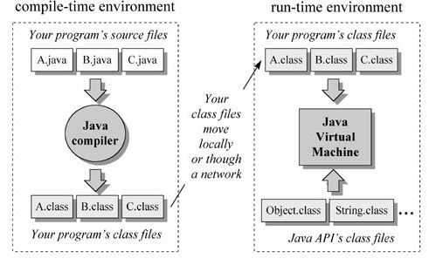

Slide 13
Process
Java Host
JVM
Class Loader
Object
Object
Object
Object
Object
Object
Object

Slide 14
Verify class
Verify method
Load Code
Load class
Load Method
Call next class
Check for
native code
Locate class
Load Native Code
JITC
Java runtime
execution model
Call next method
Execute
Native Code
Generate
Native Code

